Slide 1
Our 4th Grade
Classroom News
The Week of 11/2/2020
Mrs. Carson: lcarson@Paulding.k12.ga.us Mrs. King: stking@Paulding.k12.ga.us Mrs. Walton: rwalton@paulding.k12.ga.us
Mrs. Chapman jtallman@Paulding.k12.ga.us
Mrs. Mittelman: b mittelman@paulding.k12.ga.us Mrs. Yergin: ayergin@paulding.k12.ga.us
Reading and Writing
Reminders
RL1: Refer to details and examples in a text when explaining what the text says explicitly and when drawing inferences from the text.
RL3: Describe in depth a character, setting, or event in a story or drama, drawing on specific details in the text (e.g., a character’s thoughts, words, or actions)
RL9: Compare and contrast the treatment of similar themes and topics and patterns of events in stories, myths, and traditional literature from different cultures.
Informational Writing
W2: Write informative/explanatory texts to examine a topic and convey ideas and information clearly.
November
3rd: No School Election Day
13th: Progress Reports in
Parent Portal (no paper copies)
23rd-27th: Thanksgiving Break
Math
NBT5: Multiply multi digit numbers (1x4 digit, 2x2 digit) using place value, properties of multiplication, equations, area models, and/or arrays.
MD8: Recognize area as additive. Find areas of rectilinear figures by decomposing them into non-overlapping rectangles and adding the areas of the non-overlapping parts, applying this technique to solve real world problems
Specials Rotations
 | Mon | Tue | Wed | Thurs | Fri | Mon
Carson | Music E | PE | Counselor | Art | Music J | Music E
Chapman | Music J | Music E | PE | Counselor | Art | STEM
King | Counselor | Art | Music J | Music E | PE | PE
Walton | PE | Counselor | Art | Music J | Music E | Music J

Slide 2
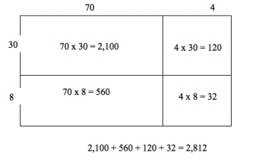
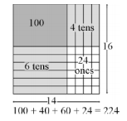
How we teach Multiplication
Array/Area Model
The area model below shows the partial products for 14 x 16 = 224. Using the area model, students first verbalize their understanding:
• 10 x 10 is 100
• 4 x 10 is 40
• 10 x 6 is 60, and
• 4 x 6 is 24.
What would an array area model of 74 x 38 look like?
Distributive Property
(decomposing larger number)
To illustrate 154 x 6, students use base 10 blocks or use drawings to show 154 six times. Seeing 154 six times will lead them to understand the distributive property
Multiplication Videos
https://www.youtube.com/watch?reload=9&v=MVZRD4Fa1OY
https://www.youtube.com/watch?v=WYJsQo7ZTC4

